Slide 1


MGHSOGA UKIE
&
Annual General Meeting
&
146TH Founder’s Day CELEBRATIONS
Saturday 15th November 2025

Slide 2
Annual General meeting

Slide 3
Agenda
Opening prayer
Welcome by President
Adoption – Minutes of AGM 2024
Annual Report 2025
Proposals for next year
Q&A
Closing remarks
Closing prayer

Slide 4
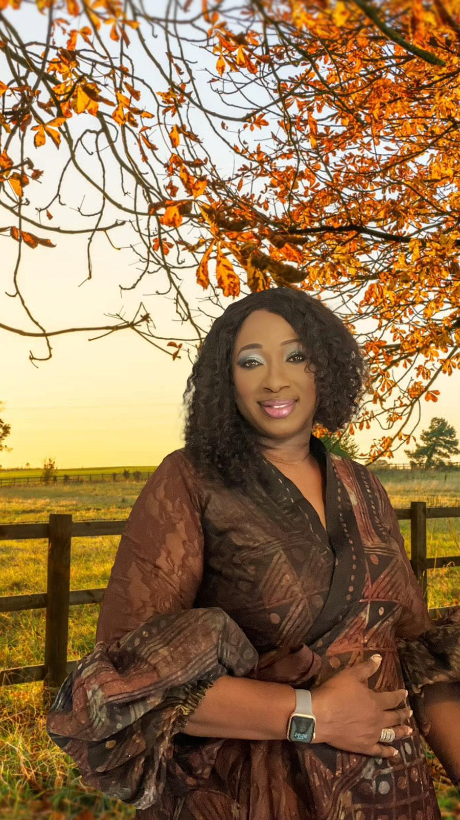
Welcome Address - President

Slide 5

MGHSOGA UKIE Annual Report 2025

Slide 6
Finance Report
A statutory audit is not legally required but as in previous years, one of our sisters, a Chartered Accountant has voluntarily reviewed our accounts. She did not report any area of concern.
2025
Dues to date | 2,932.52
Welfare | 775.12
Picnic in the Park | 1,240.00
Building Fund | 2,987.00
Outgoings | 1,608.28
Balance as at 3 Oct 25 | 34,305.17

Slide 7
MGHSOGA UKIE Annual Report 2025
Extract from INDEPENDENT REView BY OLUbunmi Oyewunmi
Opening Bank Balance | 30,646.9
Income | 5,266.6
Expenditure | - 1608.28
Closing Bank balance | 34,305.20
Summary by Income and Expenditure
Dues to date 2,932.52
Welfare 775.12
Picnic in the Park 1,240.00
Building Fund 2,987.00
Outgoings 1,608.28
Balance at 3 Oct 25 34,305.17

Slide 8
Membership dues 2025
Amount: £35
Account Details
Barclays Bank OGMG UK & IRL
Sort code 20 45 45 Account 33575705
Ref Initial Surname Set Dues on bank payment
Notification of payments should be sent to sis Kemi Ogunmuyiwa's email address: kemiogunmuyiwa@yahoo.co.uk
Titled Dues
Thank you Finance Team

Slide 9
Questions and Answer

Slide 10
Proposals for next year
President
Welfare
Finance
Socials

Slide 11

Closing remarks
MBHS & MGHS Christmas Carol Service on 14th December
2025 at 3.00pm venue Walworth Road Methodist Church
End of Year Prayer on zoom: 27th December 2025 at 8.00am
MGHS OGA UKIE Lit Day: 4th July 2026
Share your ideas, thoughts with us –secretariat@mghsoga.co.uk

Slide 12
Closing prayer

Slide 13
Thank you so much for coming,
we appreciate your contribution and presence, Up School !!!
Must Gain High Standard
In love serve one another

